Slide 1
Airline Safety-Executive summary
- Pradeep Kumar Vallepalli

Slide 2
Contents
Introduction
Total airline accidents vs fatal accidents
Airline Accidents by year
Airline Hijackings
Top 10 years with most Airline Accidents
Airline Fatalities
Conclusion

Slide 3
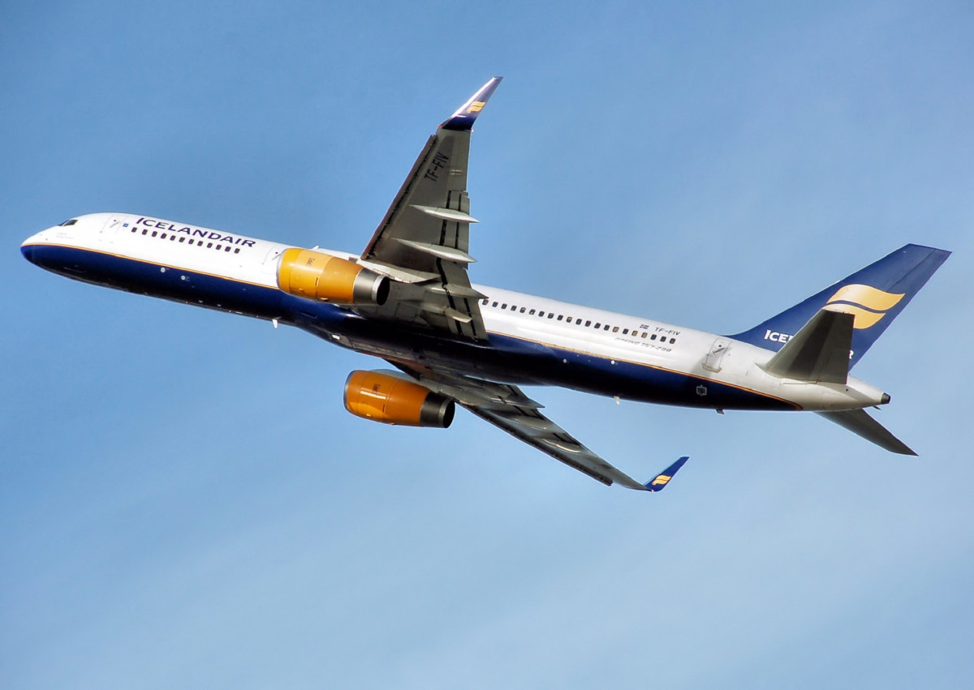
Introduction
Airline passengers may feel strongly about airline safety, so we think they should receive 100% accuracy. Any single, comprehensive measurement of airline safety must offer precisely that - a single rating format without any gaps due to variations in how safety incidents may or may not be reported.

Slide 4
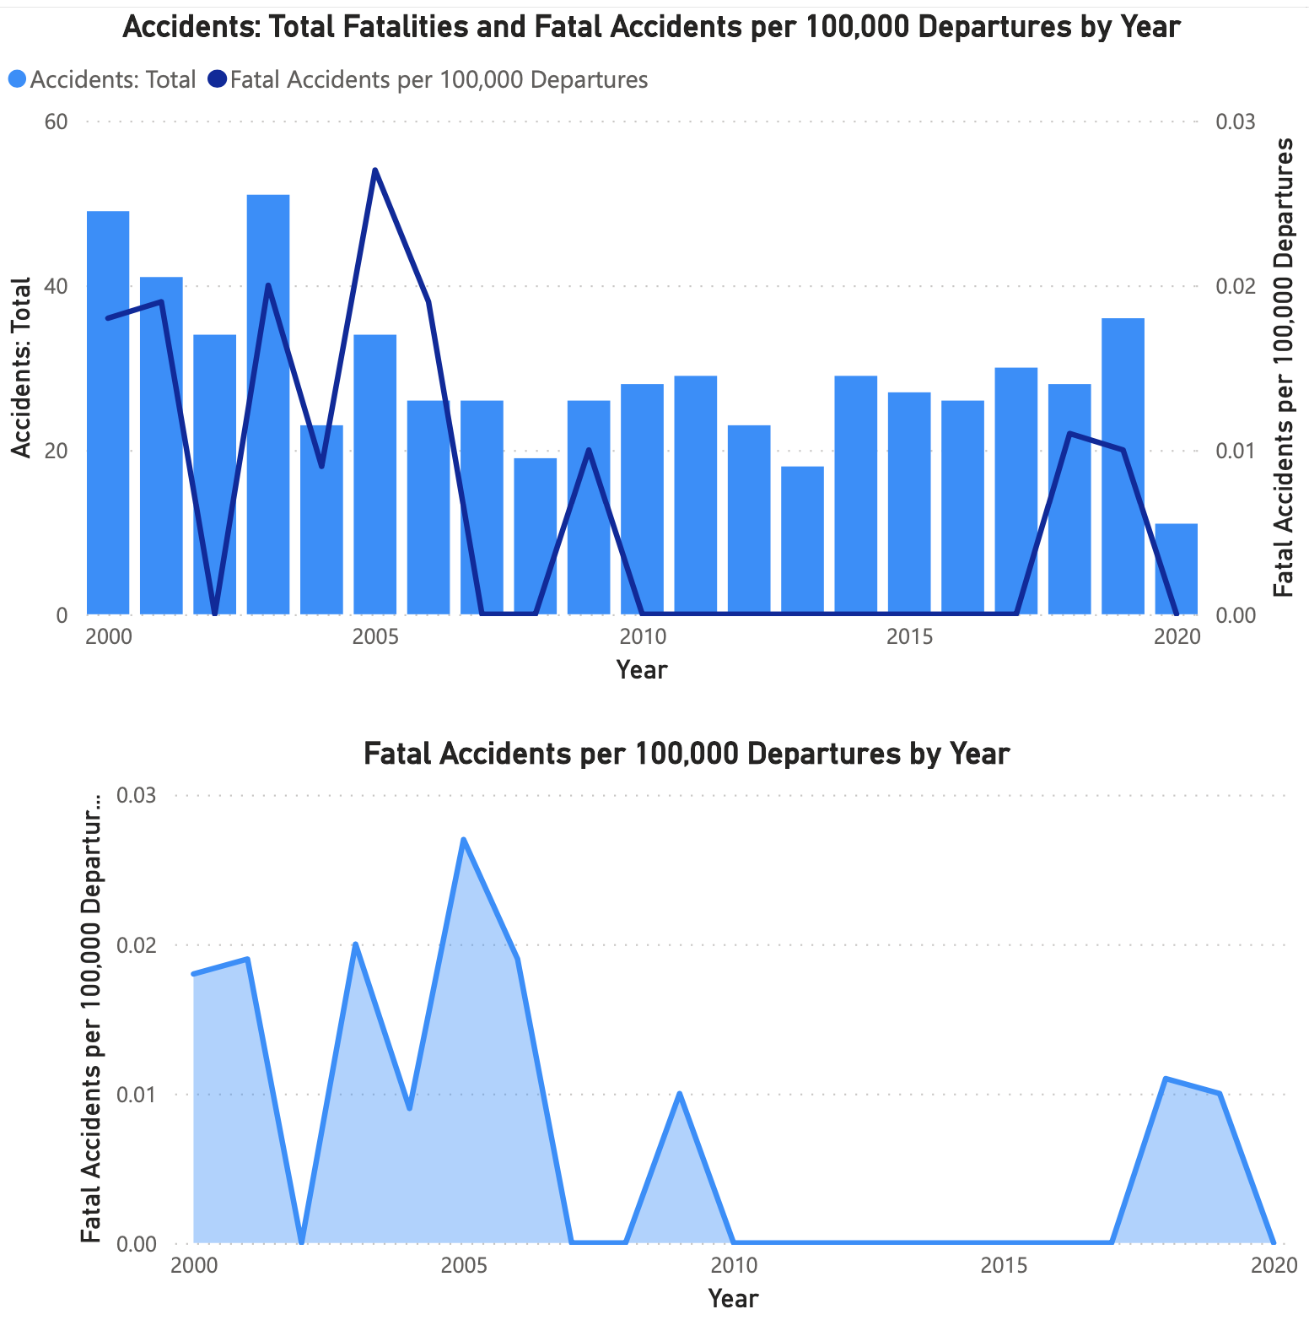
Total airline Fatalities
By examining the total number of accidents over last 2 decades, there is a bump in accidents in 2019 due to Boeing issue but if we look at the bottom graph there is a significant decline in fatal accidents over the years. The past few years, the number has decreased, demonstrating the safety of air travel.

Slide 5
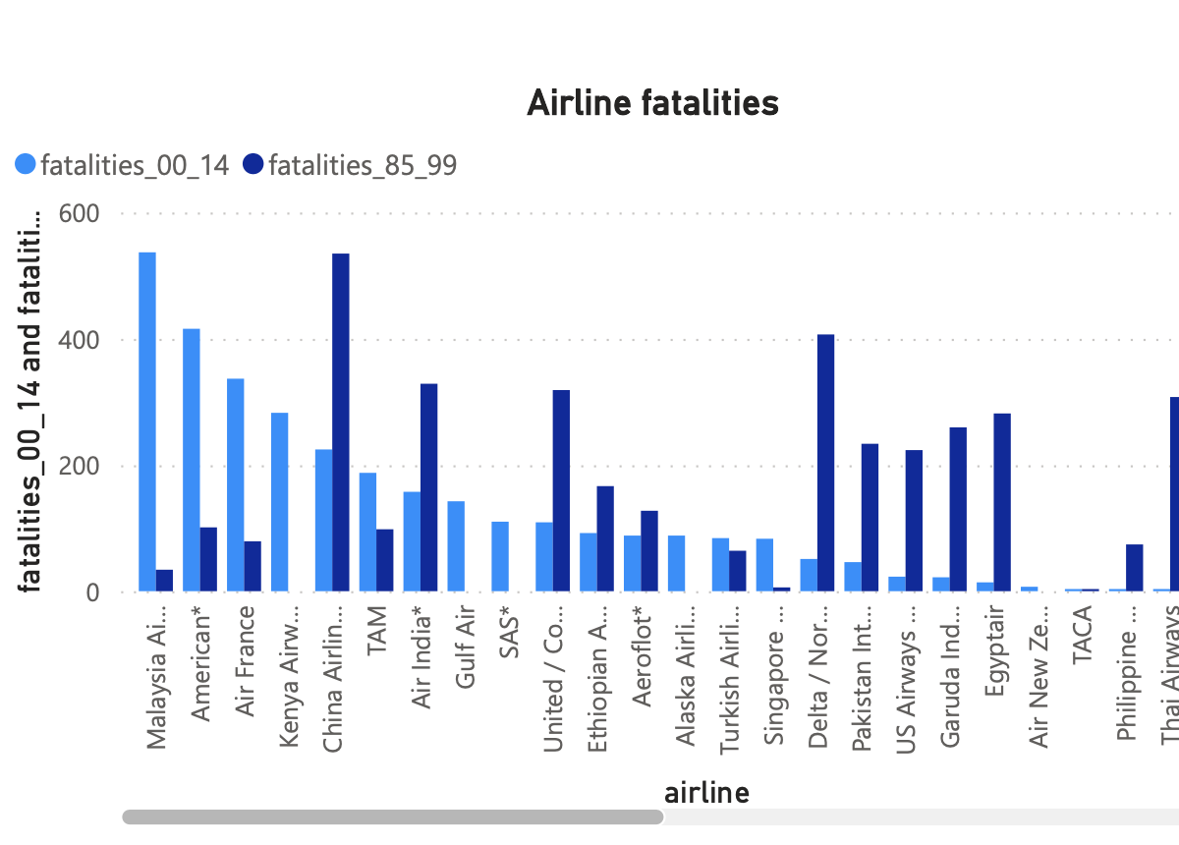
Airline fatalities
The graph displays the number of airline fatalities from 1985 to 1999 and from 2000 to 2014. Since there is no harm to the passenger health, in the 2000 period new airlines got started and running successfully. Over the following period, the airlines with the highest fatality rates have decreased gradually and showing successful travel history.

Slide 6
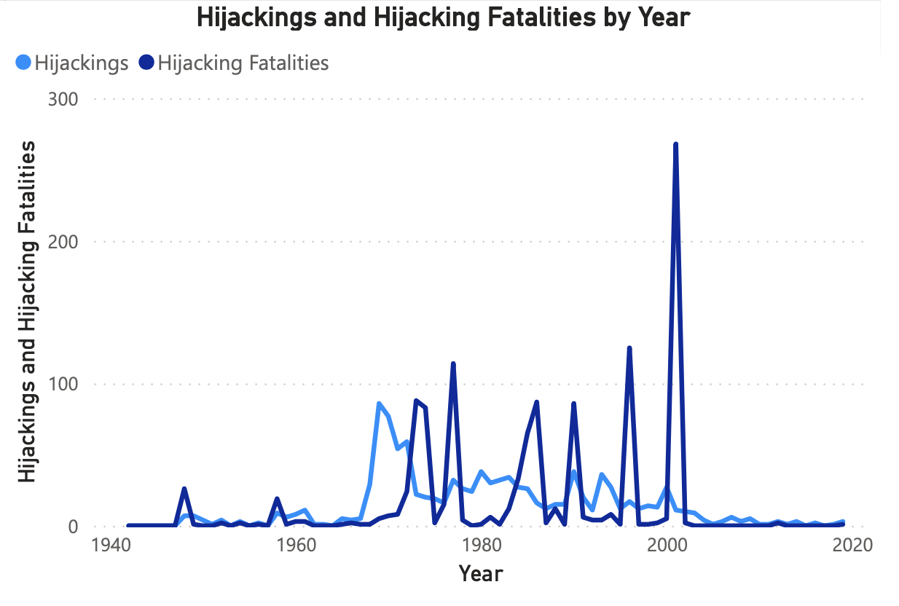
Airline hijack
The graph for fatalities and hijackings shows how both numbers dramatically decreased after the 9/11 terrorist attack in 2001. This demonstrates that over the last 20 years, flying has gotten safer.

Slide 7
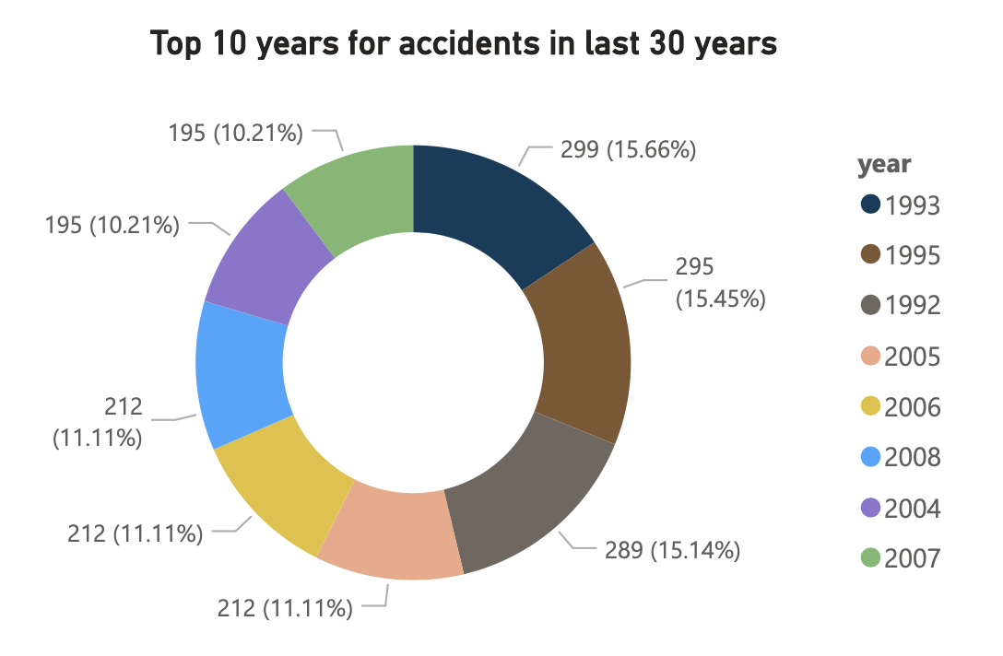
Top 10 years with most Airline Accidents
In the last 30 years, top 10 years with highest airlines accidents are 90’s and 2000’s. Last decade has been safer with a very accidents relative to the number of flight hours and number of trips.

Slide 8
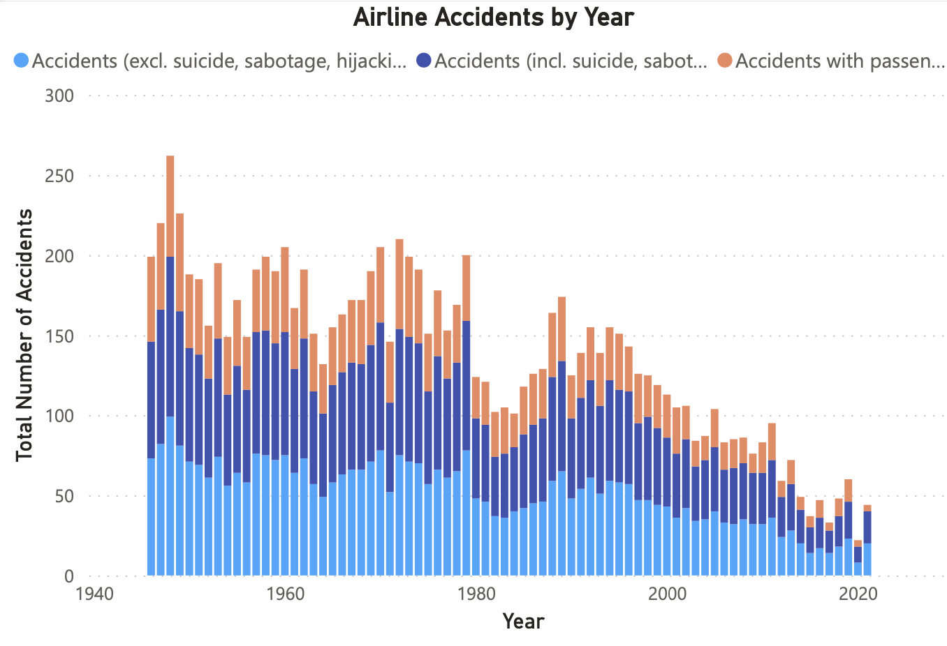
Airline Accidents by year
The statistics shows the trend for airline accidents over the period 1945-2022. We can observe that the total accidents got drastically reduced over the period of time. The number of incidents reported are very minimal and it shows air travel is safe.

Slide 9
Conclusion
Most travelers who are familiar with the airline industry think that flying is safe. But when something unusual happens that we can't explain, any of us may become frightened very quickly.
All the statistics shows that airline travel still safer and can be considered without any doubt.
Despite a fifty percent increase in passengers during the past ten years, there was a forty percent decrease in the number of fatal accidents and a twenty-five percent decrease in the number of fatalities, according to accident statistics provided by the National Transportation Safety Board.

